Slide 1
Application of Convex Optimisation
Portfolio making using convex optimisation
01
Mihir Mallick 21CS30031
Aatir Zaki 21CH10092

Slide 2
02
Introduction
Choosing the right Mandatory Provident Fund (MPF) portfolio is essential for a secure retirement. Portfolio optimisation provides a structured way to balance risk and return, using data-driven strategies to align investments with individual risk tolerance and financial goals.
Maximise the Returns,
Minimise the risk !

Slide 3
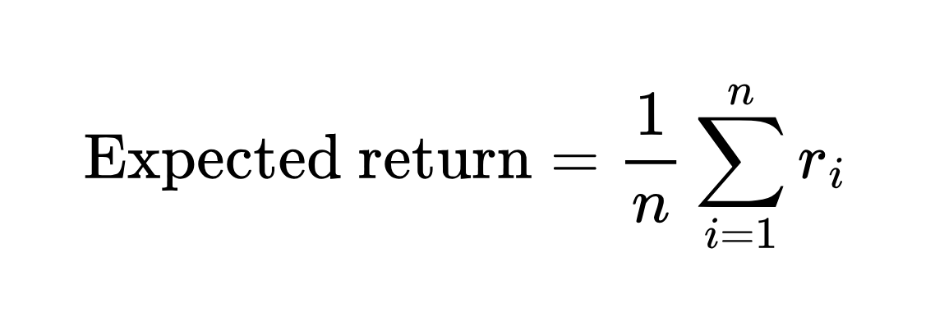
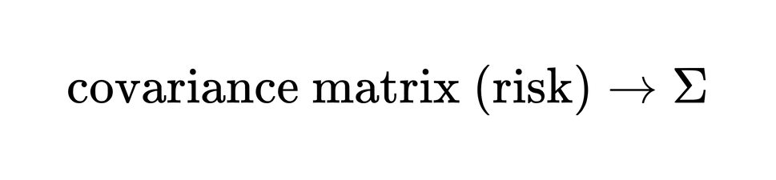
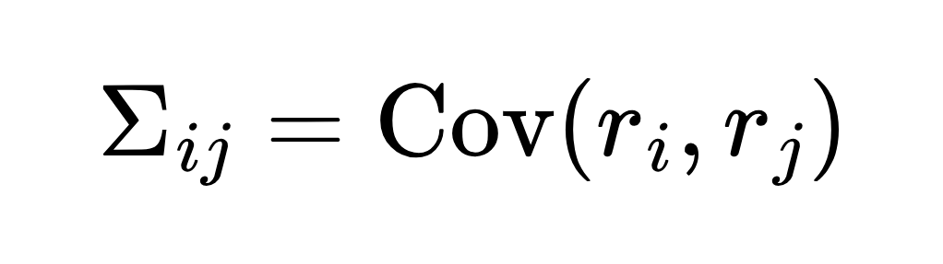
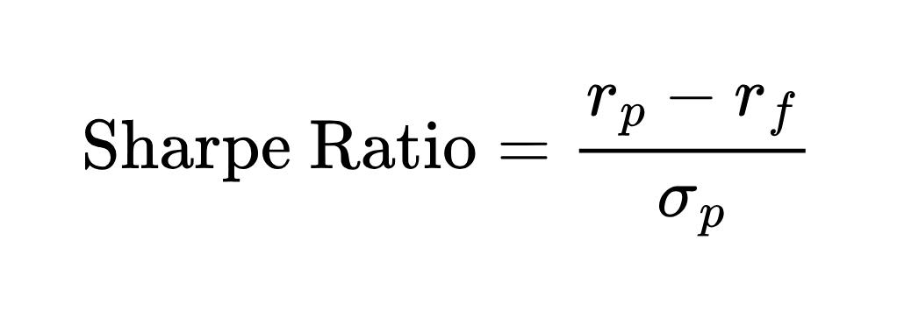
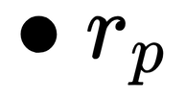
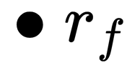
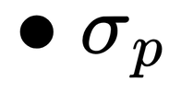
03
Some terminology :
is the annualised return of the portfolio
is the risk free rate
is the standard deviation of the portfolio

Slide 4
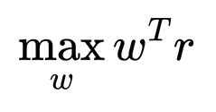
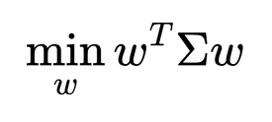
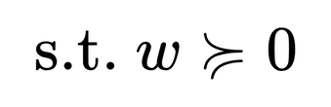

04
GOAL :
Weights (w):
We want to find a set of non-negative weights, so that weighted sum of the assets results in the maximum possible expected return and minimum risk.

Slide 5
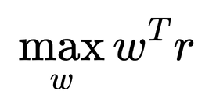
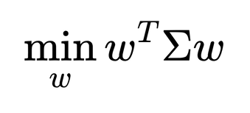
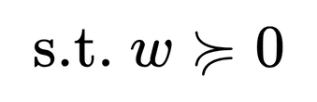
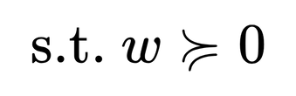


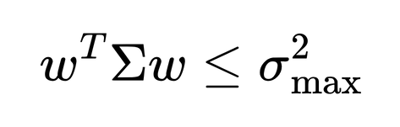
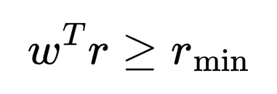
05
Our approach :
Maximising the expected return
(Quadratic Constrained Quadratic Programming)
Minimising the portfolio variance [risk]
(Quadratic Programming)

Slide 6


05
Dataset
We used the nifty-50 stock market data sourced from Kaggle as proxy for the fund price data and selected 15 assets to conduct our analysis
The data contains historical daily closing prices of assets from 2000 to 2021
We cleaned the data by dropping unimportant features and filling in the missing values by utilising a K-nearest based approach with K=5
IMPLEMENTATION
Tools
Pandas library was used for processing and working with tabular data
Numpy was used to aid with some of the matrix calculations
CVXPY library was used to formulate the convex optimisation problem and solve it while taking care of the constraints as well

Slide 7
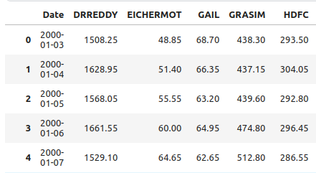
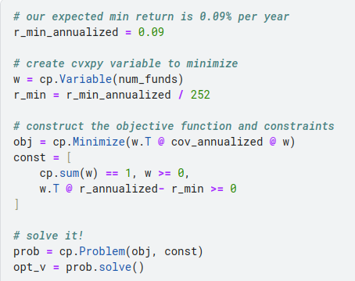
CODE Snippets
Glimpse of the Data used
problem formulation in cvxpy

Slide 8
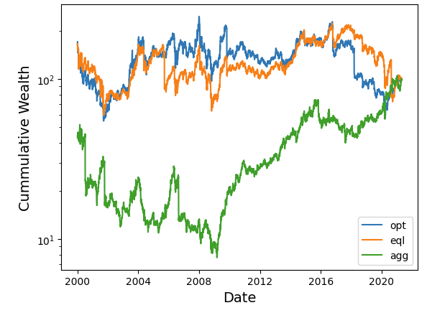
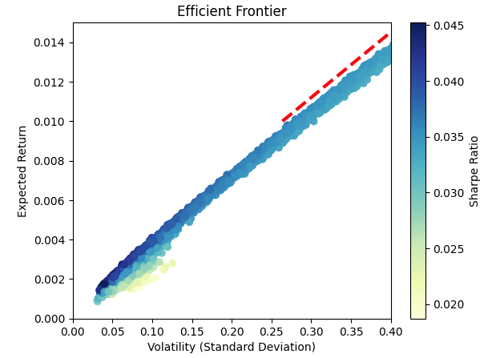
RESULTS
Optimal Risk % = 4.456%
Comparison of the different investment strategies
The pareto optimal front based on random portfolio simulations

Slide 9
08
What Next?
Pareto optimisation and Markowitz Portfolio Theory (MPT)

Slide 10
Pareto optimisation
and
Markowitz Portfolio Theory (MPT)
11
Pareto optimization is a principle from economics and multi-objective optimization that focuses on achieving the most efficient allocation of resources when dealing with competing objectives. A solution is considered Pareto optimal when no objective can be improved without worsening at least one other objective. In portfolio making, this concept applies to the trade-off between maximizing returns and minimizing risk—two inherently conflicting goals for investors. By applying Pareto optimization to portfolio selection, investors identify portfolios where any attempt to increase expected return would also increase risk, and any effort to reduce risk would decrease expected return. This application leads directly to Markowitz Portfolio Theory (MPT), which mathematically formalizes this trade-off and constructs the “efficient frontier” of optimal portfolios. MPT essentially operationalizes Pareto optimization in finance by identifying the set of Pareto-efficient portfolios that offer the best possible expected return for a given level of risk.

Slide 11
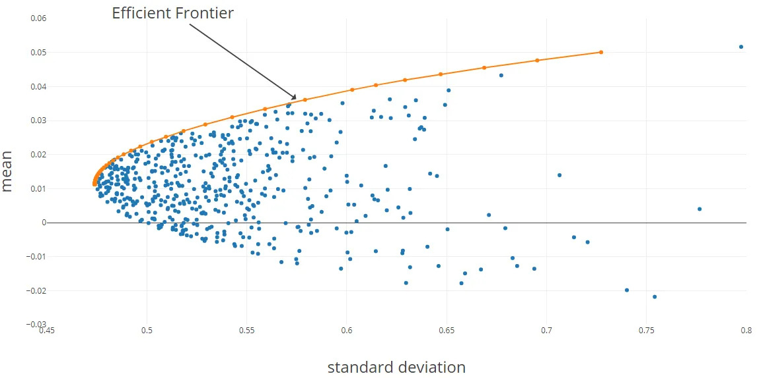
“efficient frontier” of the optimal portfolio
Image source : https://medium.com/the-modern-scientist/how-to-select-your-mpf-portfolio-wisely-portfolio-optimization-53c9b86621b2

Slide 12
08
Should you invest in this portfolio?
Yesn’t
:)

Slide 13
14
Drawbacks :
• Focuses on Variance Rather Than Downside Risk :
Modern Portfolio Theory equates higher variance with greater risk, treating all deviations from the average equally. This approach can underestimate the impact of negative downturns (losses), making portfolios vulnerable to extreme market conditions where the potential for severe losses is greater.
• Past Performance is Not Indicative of Future Results :
MPT relies on historical data to guide portfolio optimization, assuming past market behaviors will predict future outcomes. This can misalign strategies when unexpected economic or geopolitical events occur, making past performance a poor predictor of future returns and potentially leading to inadequate investment decisions.

Slide 14
15
References :
https://medium.com/the-modern-scientist/how-to-select-your-mpf-portfolio-wisely-portfolio-optimization-53c9b86621b2
4.7.3 Pareto optimal points and values, Boyd, Stephen, and Lieven Vandenberghe. Convex Optimization. Cambridge University Press, 2004
Thank You !

